Slide 1
Retex Bootstrap
HTML5 – CSS - JQuerry

Slide 2
What is Bootstrap?
Bootstrap is a free front-end framework for faster and easier web development
Bootstrap includes HTML and CSS based design templates for typography, forms, buttons, tables, navigation, modals, image carousels and many other, as well as optional JavaScript plugins
Bootstrap also gives you the ability to easily create responsive designs
What is Responsive Web Design?
Responsive web design is about creating web sites which automatically adjust themselves to look good on all devices, from small phones to large desktops.

Slide 3
Why Use Bootstrap?
Advantages of Bootstrap:
Easy to use: Anybody with just basic knowledge of HTML and CSS can start using Bootstrap
Responsive features: Bootstrap's responsive CSS adjusts to phones, tablets, and desktops
Mobile-first approach: In Bootstrap 3, mobile-first styles are part of the core framework
Browser compatibility: Bootstrap is compatible with all modern browsers (Chrome, Firefox, Internet Explorer, Edge, Safari, and Opera)

Slide 4
Where to Get Bootstrap?
There are two ways to start using Bootstrap on your own web site.
You can:
Download Bootstrap from getbootstrap.com
Include Bootstrap from a CDN

Slide 5
Bootstrap CDN
If you don't want to download and host Bootstrap yourself, you can include it from a CDN (Content Delivery Network).
MaxCDN provides CDN support for Bootstrap's CSS and JavaScript. You must also include jQuery:
<!-- Latest compiled and minified CSS -->
<link rel="stylesheet" href="https://maxcdn.bootstrapcdn.com/bootstrap/4.4.1/css/bootstrap.min.css">
<!-- jQuery library -->
<script src="https://ajax.googleapis.com/ajax/libs/jquery/4.4.1/jquery.min.js"></script>
<!-- Latest compiled JavaScript -->
<script src="https://maxcdn.bootstrapcdn.com/bootstrap/4.4.1/js/bootstrap.min.js"></script>

Slide 6
Ajout des fontawesomes ou Glyphicons
Bootstrap 4 et plus
Bibliothèque de Glyphicons gratuits pas disponibles
Bibliothèque de Fontawesomes gratuits disponibles
Version inférieur
: Bootstrap ( 3.4.1, …. )
Bibliothèques de Glyphicons et Fontawesomes gratuits disponibles

Slide 7
Bootstrap StyleSheet link
<link rel="stylesheet" href="https://stackpath.bootstrapcdn.com/bootstrap/4.4.1/css/bootstrap.min.css" integrity="sha384-Vkoo8x4CGsO3+Hhxv8T/Q5PaXtkKtu6ug5TOeNV6gBiFeWPGFN9MuhOf23Q9Ifjh" crossorigin="anonymous">

Slide 8
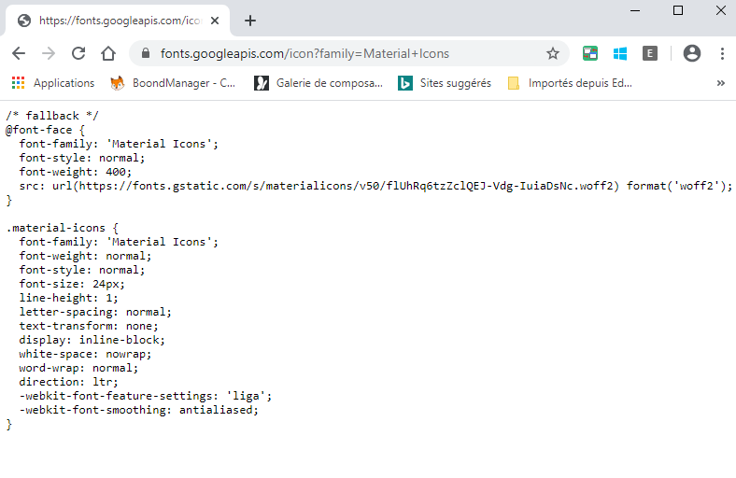
Links pour Fontawesome :
<link href="https://fonts.googleapis.com/icon?family=Material+Icons" rel="stylesheet">

Slide 9
<!-- Navigation -->
<nav class="navbar navbar-expand-lg navbar-dark bg-dark fixed-top">
<div class ="container-fluid">
<div class = "row" id="row_0">
<a class="navbar-brand pt-0" href="#">Market Bi</a>
<button class="navbar-toggler" type="button" data-toggle="collapse" data-target="#navbarResponsive" aria-controls="navbarResponsive" aria-expanded="false" aria-label="Toggle navigation">
<span class="navbar-toggler-icon"></span>
</button> <!-- fin bouton expander -->
<div class="collapse navbar-collapse" id="navbarResponsive">
<ul class="navbar-nav" id="my_nav_bar_0">
<!-- 1ere sous liste -->
<div class ="col-lg-5 justify-content-left">
<ul class="navbar-nav" id="sous liste 1">
</ul>
</div>
<!-- 2eme sous liste -->
<div class ="col-lg-4 justify-content-center">
<ul class="navbar-nav" id="sous liste 2">
</ul>
</div>
<!-- 3eme sous liste -->
<div class ="col-3 justify-content-right">
<ul class="navbar-nav" id="sous liste 3">
</ul>
</div>
<!-- fin des sous listes -->
</ul> <!-- fin ul, id="my_nav_bar_0" -->
</div> <!-- fin collapse, id="navbarResponsive">
</div> <!-- fin row , id="row_0" -->
</div> <!-- container -->
</nav> <!-- fin grand navbar -->

